Slide 1
Gravitational lensing
4 - Lens mapping, magnification
Massimo Meneghetti
AA 2017-2018

Slide 2
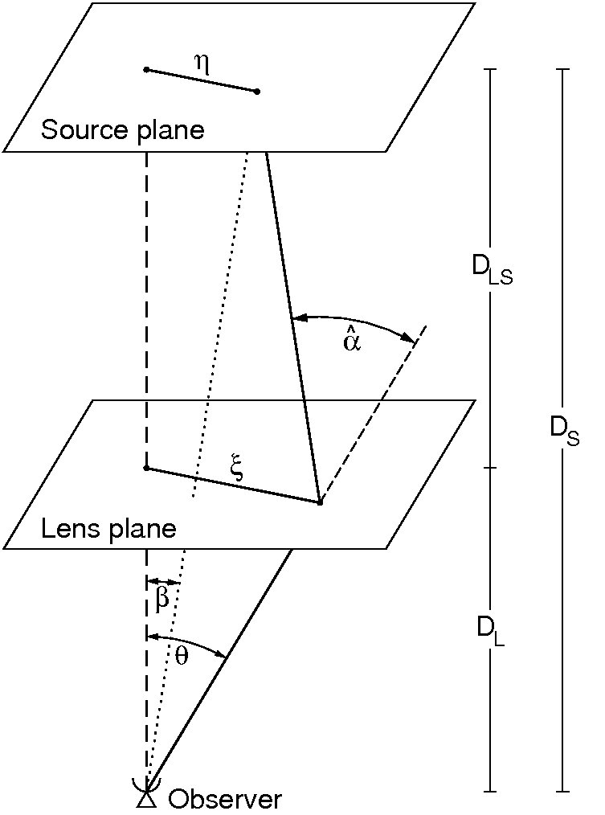
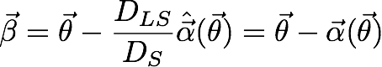
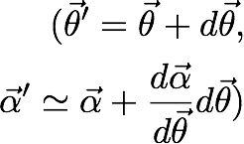
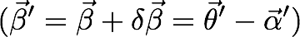
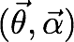
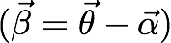
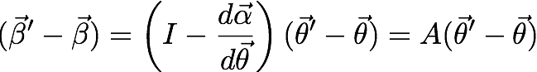
Lens mapping (first order)
we derived the lens equation
Assuming that the d.a. does not vary significantly over the scale dϴ:
Lens plane
Source plane

Slide 3
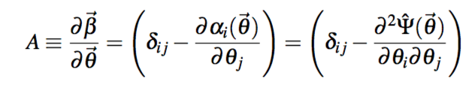
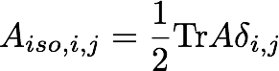
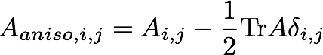
Lens mapping (first order)
A is called “the lensing Jacobian”: it is a symmetric second rank tensor describing the first order mapping between lens and source planes.
This tensor can be written as the sum of an isotropic part, proportional to its trace, and an anisotropic, traceless part.

Slide 4
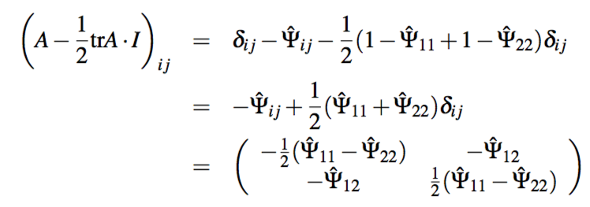

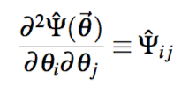
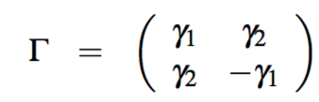
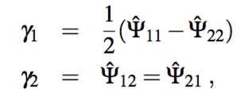
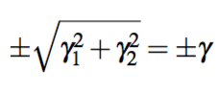
AnIsotropic part
Introducing the shear:
Symmetric, trace-less tensor with eigenvalues:

Slide 5
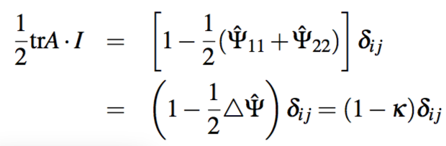
Isotropic part
Remember:

Slide 6
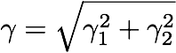
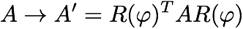
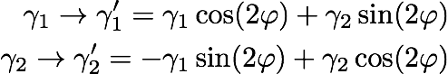
the shear is not a vector!
There is thus an orthogonal coordinate transformation R(φ), a rotation by an angle φ, which brings the Jacobian matrix into diagonal form.
Generally, the Jacobian matrix transforms as
This shows that the shear components transform under coordinate rotations as
i.e. unlike a vector! Since the shear components are mapped onto each other after rotations of φ = π rather than φ = 2π, they form a so-called spin-2 field.

Slide 7
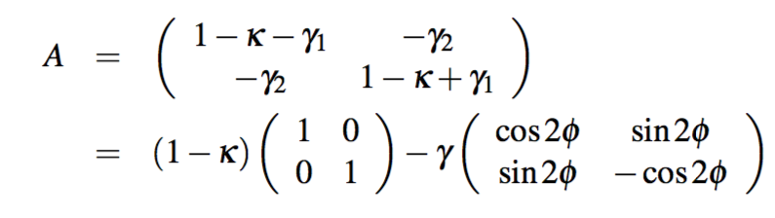
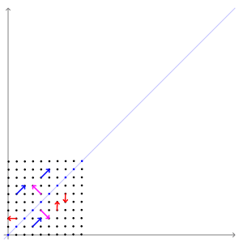
Lensing jacobian
Lens mapping at first order is a linear application, distorting areas.
Distortion directions are given by the eigenvectors of A.
Distortion amplitudes in these directions are given by the eigenvalues.

Slide 8
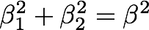
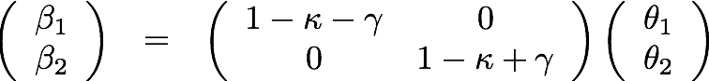
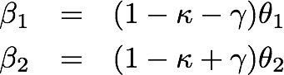
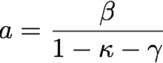
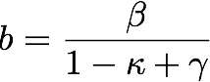
Example: first order distortion of a circular source
In the reference frame where A is diagonal:
This is the equation of an ellipse with semi-axes:

Slide 9
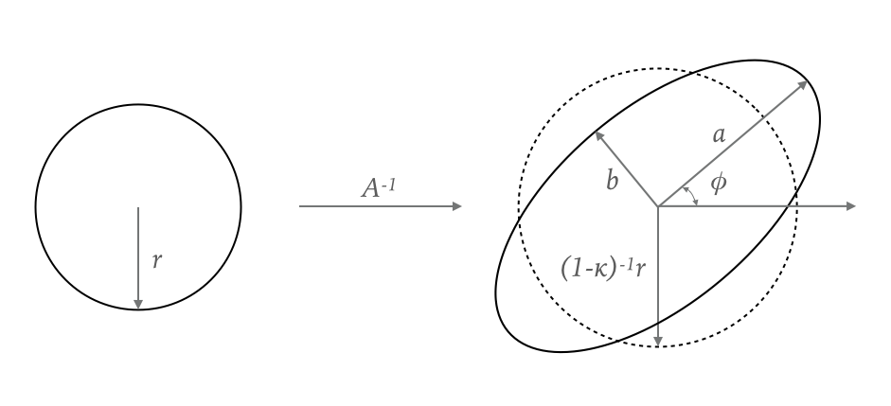
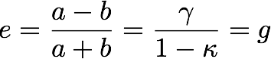
Example: first order distortion of a circular source
convergence: responsible for isotropic expansion or contraction
shear: responsible for anisotropic distortion
Ellipticity:

Slide 10
On the spin-2 nature of shear: quiz
Let’s consider a circular source
How is it distorted if we apply a pure convergence trasformation?
Now, assume that γ1>0 and γ2=0. How is the image distorted?
And what if γ1<0 and γ2=0?
Let’s set γ1=0. How is the image distorted if γ2>0?
And if γ2<0?

Slide 11
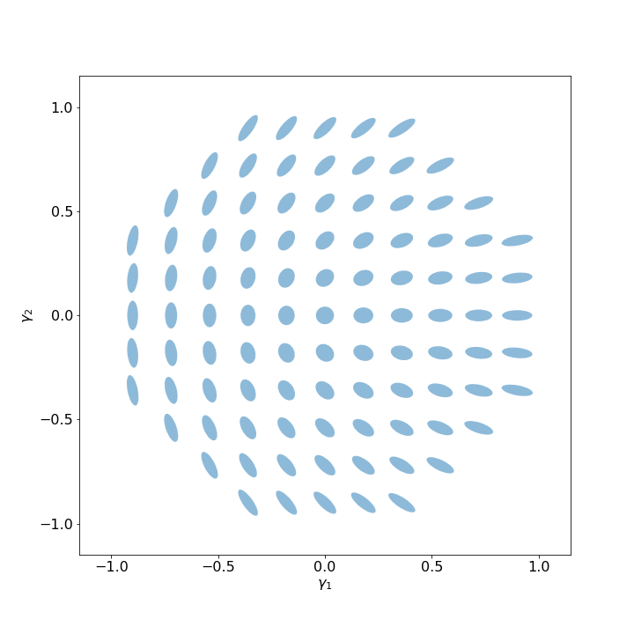
Shear distortions

Slide 12
Dependence on redshift
We have seen that the lensing potential, the deflection angle, the convergence, the shear… depend on a combination of distances.
For example, the lensing potential is:
Every spatial derivative of Ψ introduces a factor DL.
The distance ratio DLSDL/DS is called “lensing distance”.
Both the shear and the convergence, being second derivatives of the lensing potential, scale as the lensing distance

Slide 13
How does the lensing distance scale with source redshift?
Note that if the lensing distance grows, the critical surface density decreases, the convergence and the shear grow!

Slide 14
How does the lensing distance scale with lens redshift?
The lensing distance peaks at ~half way between the source and the observer, meaning that there is an optimal distance where the lens produces its largest effects.

Slide 15
How does the lensing distance scale with lens redshift?
Of course, the peak moves to larger distances as the distance to the source increases.

Slide 16
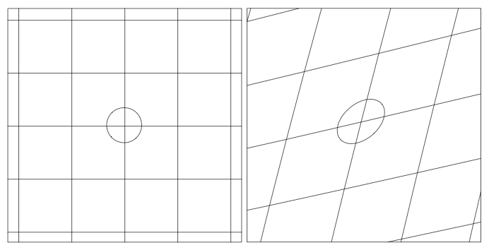

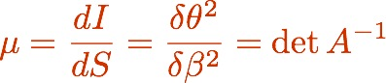
magnification
dS
dI
Kneib & Natarajan (2012)

Slide 17
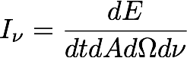
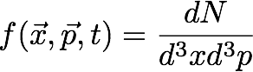
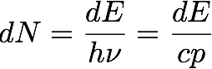
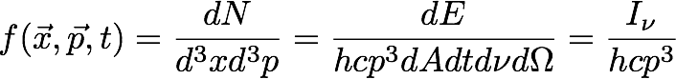
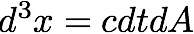
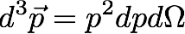
conservation of surface brightness
The source surface brightness is
In phase space, the radiation emitted is characterized by the density
In absence of photon creations or absorptions, f is conserved (Liouville theorem)
Since GL does not involve creation or absorption of photons, neither it changes the photon momenta (achromatic!), surface brightness is conserved!

Slide 18
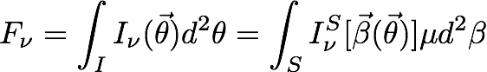
magnification
dS
dI
Kneib & Natarajan (2012)
Lensing changes the amount of photons (flux) we receive from the source by changing the solid angle the source subtends

Slide 19
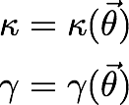
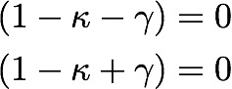
critical lines and caustics
Both convergence and shear are functions of position on the lens plane:
The determinant of the lensing Jacobian is
The critical lines are the lines where the eigenvalues of the Jacobian are zero:
tangential critical line
radial critical line
Along these lines the magnification diverges!
Via the lens equations, they are mapped into the caustics…

Slide 20
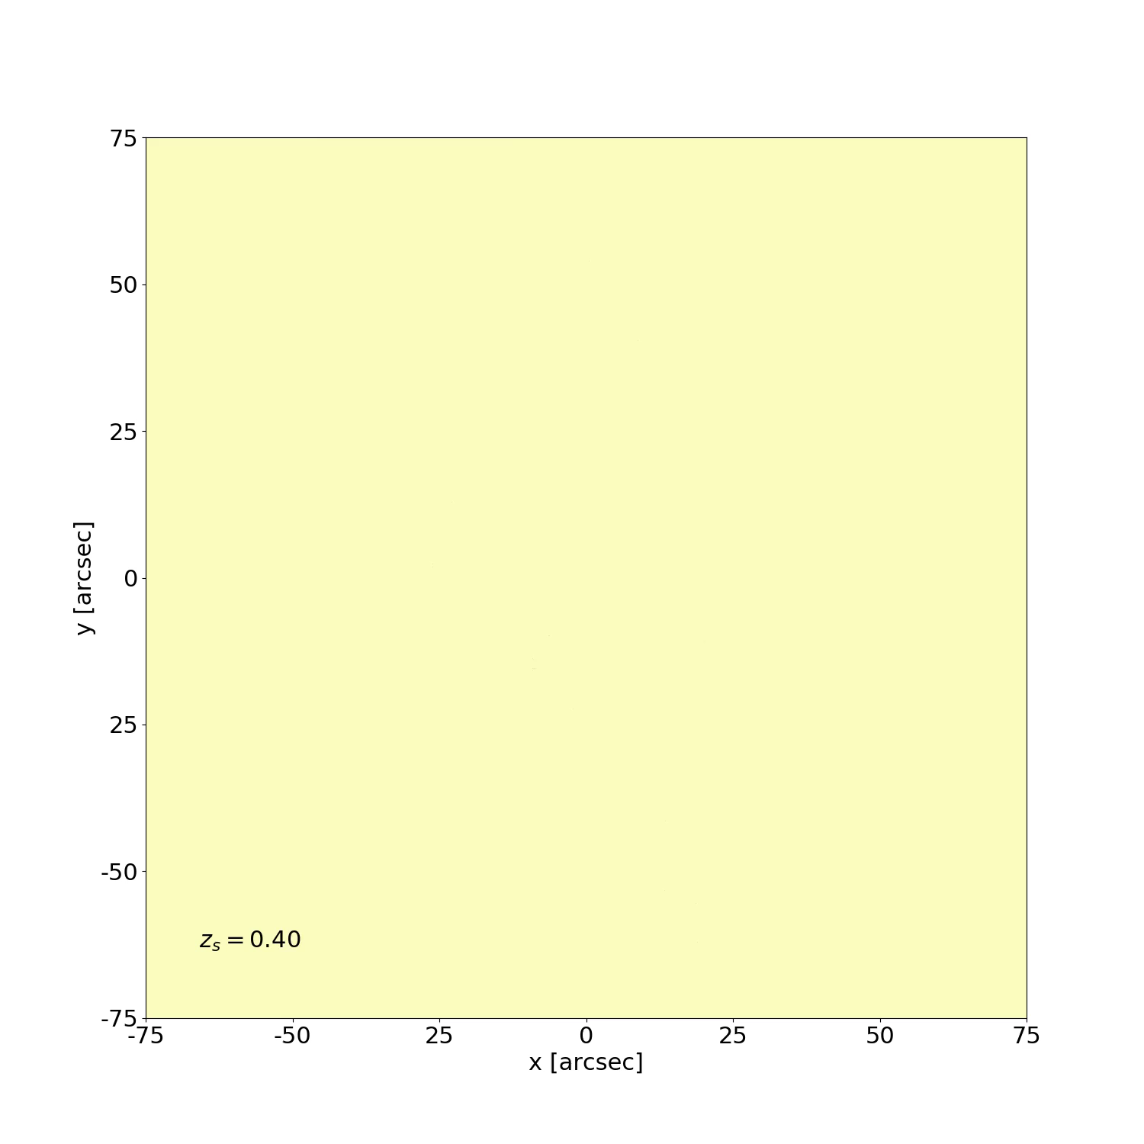
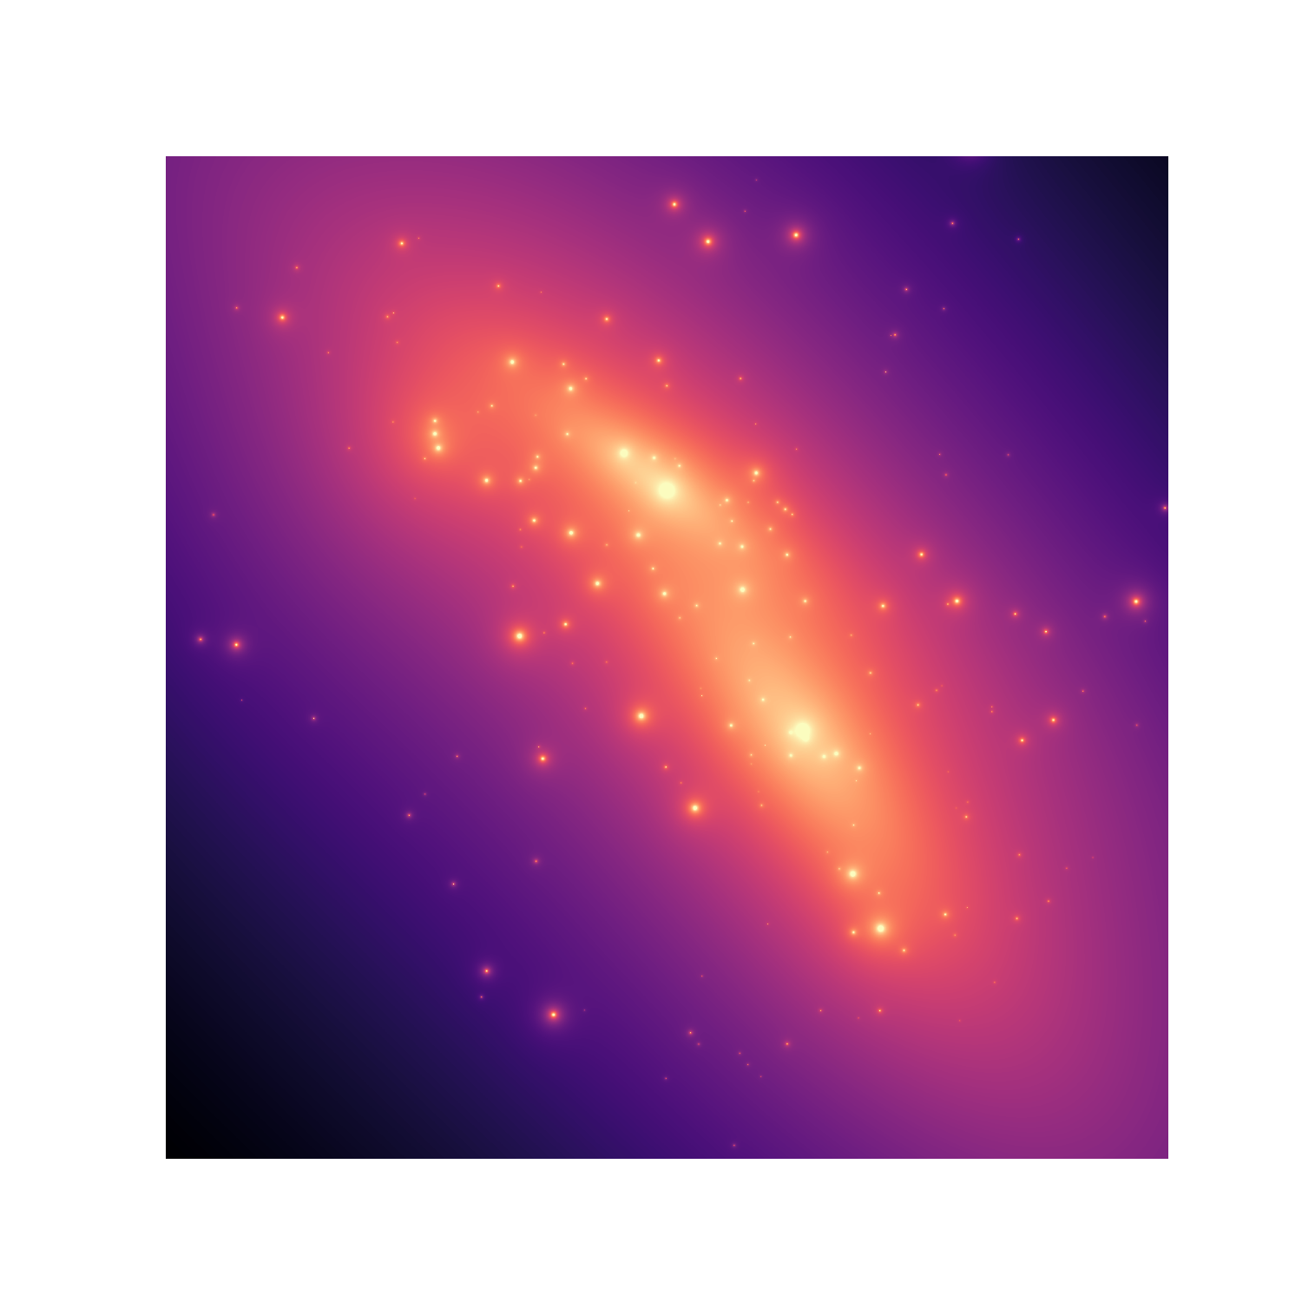

Model of MACS0416 by Caminha, MM, et al. (2016)
The sky is “folded” and “squeezed”

Slide 21
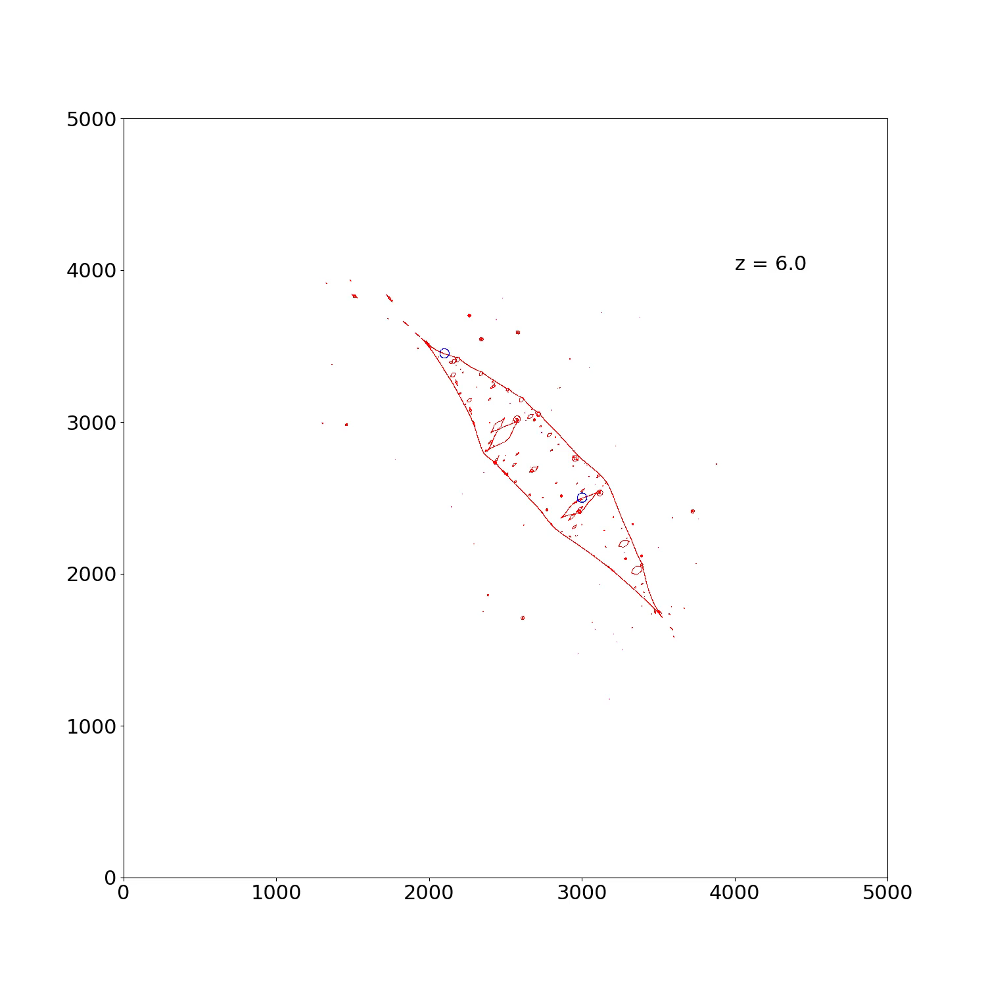
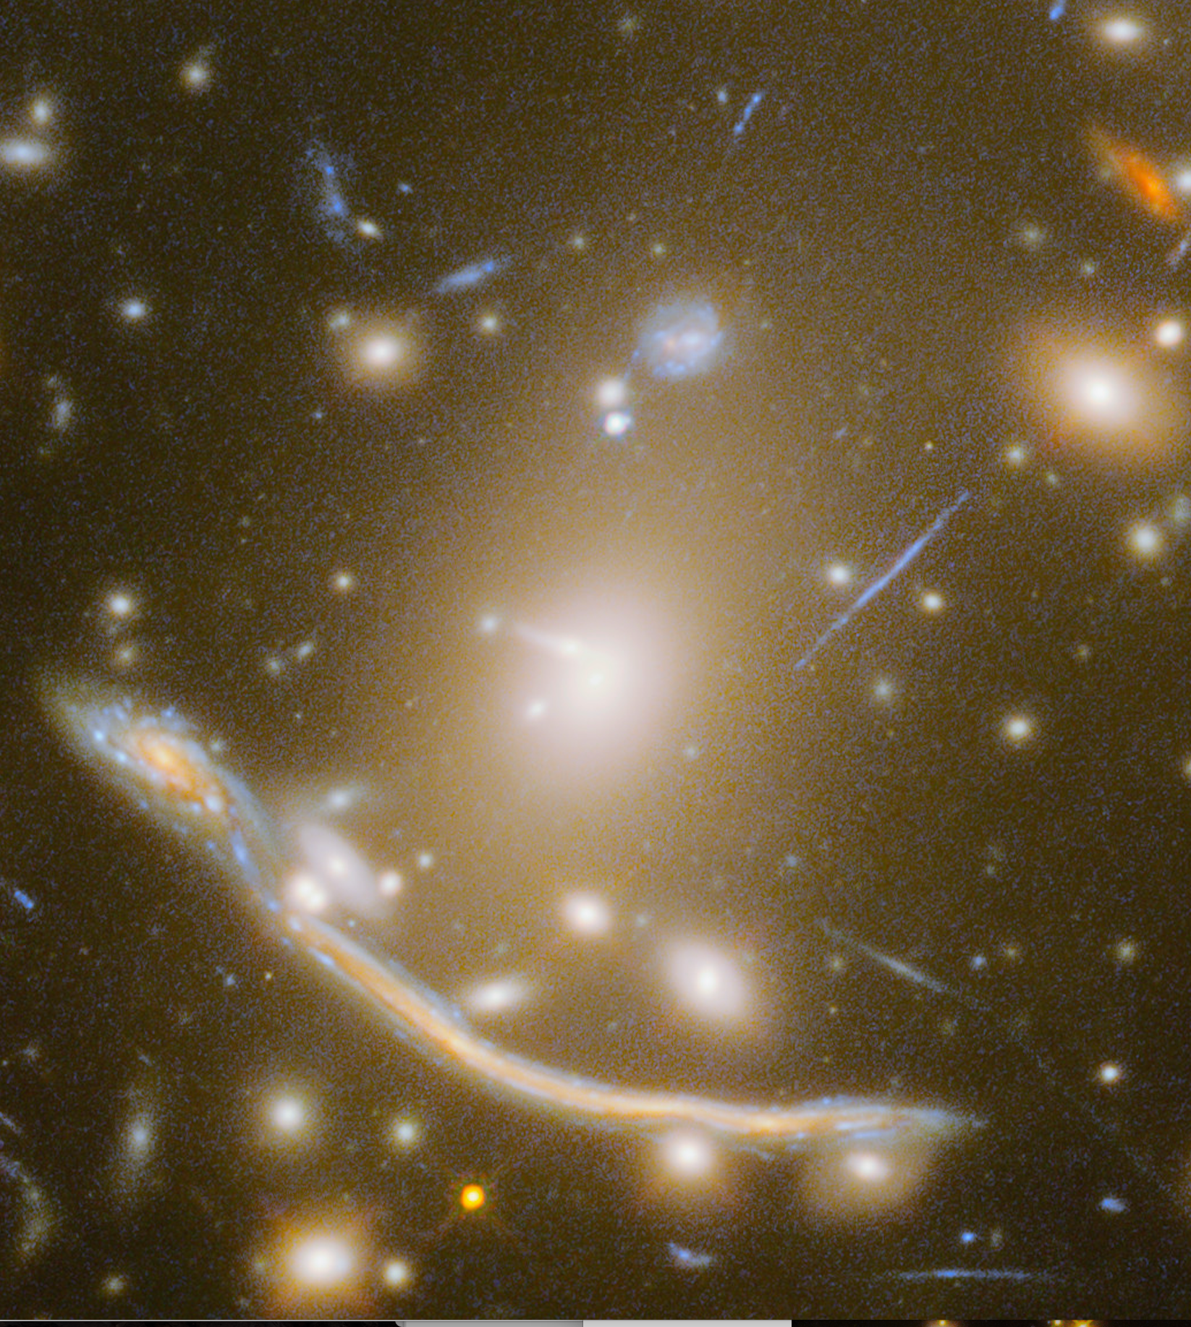

Slide 22
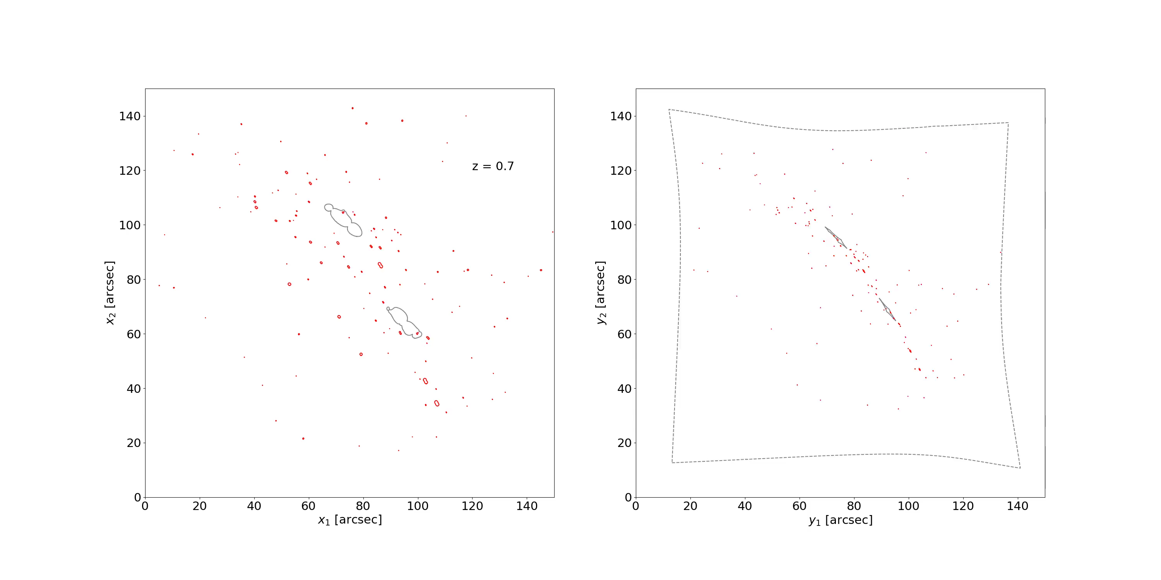
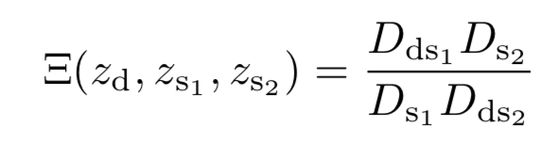
multiple images of two different sources at different redshift constrain the “family ratio”
which in turn depends on cosmological parameters (Soucail et al. 2004; Jullo et al. 2010)

Slide 23
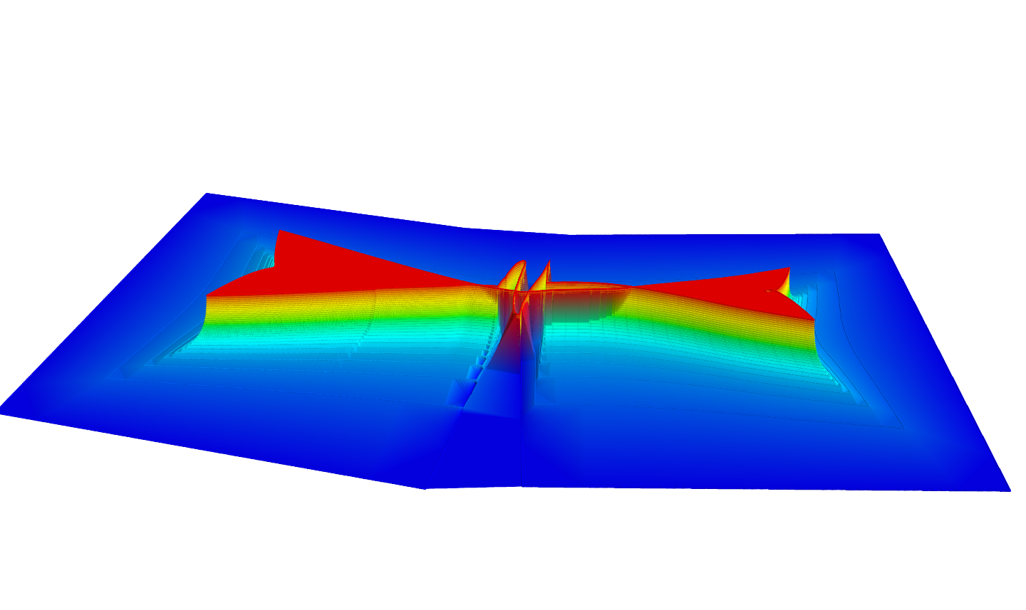
Sampled volume

